Slide 1

HIGH-PERFORMANCE SYSTEM ARCHITECTURE
Scalable Log Processing and
Forensic Archiving System
Using Rope Data Structures
A High-Performance Log Viewer for Large-Scale System Logs
Designed for Efficient Processing of Massive Log Streams
Built using Rope Data Structures and Tree-Based Memory Management
Presented by
Modern systems generate millions of log entries per day
Team OM3N
Efficient log handling requires data structures designed for scale

Slide 2
CHALLENGE IDENTIFICATION
The Problem
Limitations of Traditional String-Based Log Processing
Contiguous Memory Blocks
Memory Fragmentation
Standard strings store logs in contiguous memory blocks, creating rigid allocation patterns that limit scalability.
Memory fragmentation increases with large datasets, reducing system stability and overall performance over time.
Repeated Memory Reallocations
Poor Performance
Large log files require repeated memory reallocations, causing significant performance overhead during growth.
Poor performance when viewing or modifying large logs creates bottlenecks in critical system monitoring workflows.
O(N) Time Complexity
Key Insight: Conventional string buffers require continuous memory. When logs grow large, operations like insertion or deletion force expensive memory copying, causing performance degradation and limiting scalability for large log processing systems.
Editing operations cause O(N) time complexity, making each operation increasingly slower as log volume grows.

Slide 3
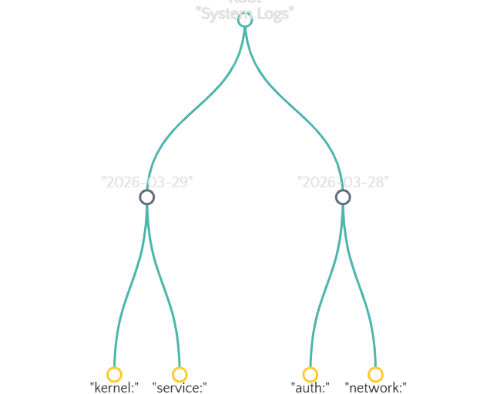
INNOVATIVE APPROACH
The Rope Solution
Rope Data Structure for Large Text Processing
What is a Rope?
Rope Tree Structure
•
Rope is a tree-based representation of strings
•
Text is stored in multiple small fragments
•
Each node stores substrings instead of full text
Supported Operations
Insert
Delete
Concatenate
Split
How it works: Ropes divide large text into smaller pieces stored in tree nodes. Instead of moving large blocks of memory, operations simply rearrange tree nodes, making the system much faster for large-scale text manipulation.
Time Complexity
O(log N)
for most operations

Slide 4
SYSTEM DESIGN
System Architecture
Log Viewer Processing Pipeline
Log Source
Processing
Storage
Interface
System Logs
journalctl
Web UI
Rope Data Structure
MySQL Database
Command Logs
Forensic Archive
• Search & Filter
• Delete & Archive
eBPF monitoring
Pipeline Flow: Logs are collected from the Linux system, inserted into the Rope data structure for efficient storage, then displayed in a web-based viewer. Deleted logs are archived into a database for forensic tracking.

Slide 5
CAPABILITIES
Built-in Features
Functional Capabilities of the System
Instant Log Loading
Live Monitoring
Efficient Viewing
Efficient ingestion of thousands of logs with minimal latency. The Rope structure enables rapid data insertion without memory reallocation overhead.
Real-time monitoring using eBPF and system logs. Capture system events as they happen with minimal performance impact.
Display last N logs instantly. Tree-based indexing allows O(log N) retrieval of any log segment regardless of total size.
Zero-copy insertion
eBPF integration
O(log N) retrieval
Date Filtering
Forensic Deletion
Retrieve logs for specific timestamps with precision. Time-range queries execute efficiently using tree traversal.
Deleted logs stored securely in database for compliance and audit trails. Every deletion is tracked with timestamps and user information, ensuring complete forensic traceability.
Range queries
Audit trail
Compliance ready
Secure archive
Key Advantage: The system supports real-time monitoring, fast log viewing, and forensic deletion tracking. These features make it useful for security analysis and system debugging.

Slide 6
CORE MECHANICS
Implementation
Rope Operations: Split and Merge
Split Operation
Merge Operation
Divides the rope at a given position, producing two separate trees. This operation is fundamental for text editing and log segmentation.
Combines two rope trees into one. This enables efficient concatenation without copying large memory blocks.
// Split at index position
// Concatenate two ropes
functionsplit(tree, index):
functionmerge(leftTree, rightTree):
leftTree ← new Rope()
newRoot ← new Node()
rightTree ← new Rope()
newRoot.left ← leftTree.root
// Traverse and split nodes
newRoot.right ← rightTree.root
traverseAndSplit(tree.root, index)
newRoot.weight ← leftTree.length
return (leftTree, rightTree)
return new Rope(newRoot)
Visual Representation
Time Complexity
O(log N)
Before Split
After Split (at position 3)
Implementation Note: Split and merge operations allow fast editing of large text blocks. Instead of modifying entire strings, the system simply restructures tree nodes.

Slide 7
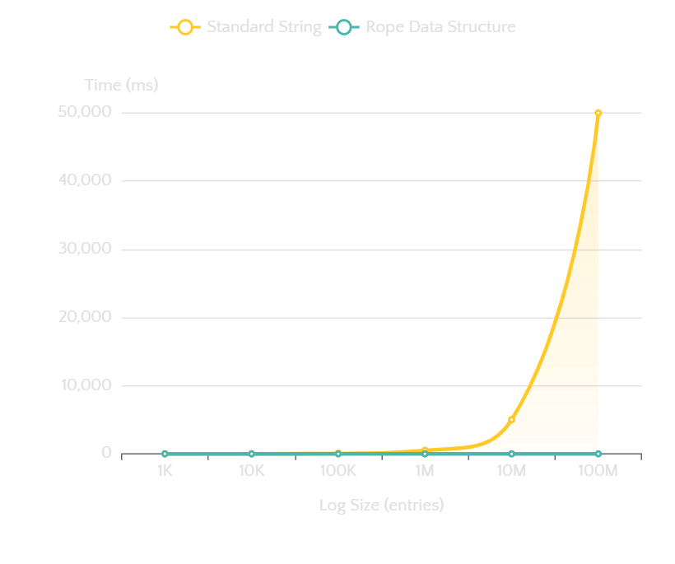
COMPARATIVE ANALYSIS
Performance Benefits
Efficiency Compared to Standard Strings
Complexity Comparison
Performance Visualization
Operation | String | Rope
Insertion | O(N) | O(log N)
Deletion | O(N) | O(log N)
Concatenation | O(N) | O(1)
Key Benefits
Reduced Memory Copying
Tree restructuring eliminates large block copies
Faster Editing
Logarithmic time for large text operations
Improved Scalability
Performance remains stable as data grows
Performance Insight: Rope structures significantly improve performance for operations involving large texts such as log files. This makes them ideal for log viewers and editors where text size can reach gigabytes.

Slide 8
ROADMAP
Future Enhancements
Potential Improvements and Extensions
Multi-threaded Ingestion
Regex-Based Search
Distributed Storage
Parallel log processing across multiple CPU cores for dramatically improved throughput. Implement lock-free data structures for concurrent rope operations.
Advanced pattern matching with regular expression support for complex log analysis. Enable sophisticated filtering and anomaly detection capabilities.
Horizontal scaling across multiple nodes for enterprise-grade deployments. Implement sharding strategies for massive log volumes.
10x throughput increase
Complex pattern matching
Unlimited scalability
Visualization Dashboards
SIEM Integration
AI Anomaly Detection
Interactive charts and graphs for intuitive log data representation. Real-time metrics and trend analysis with customizable widgets.
Enterprise security information and event management system compatibility. Export to Splunk, ELK Stack, and other SIEM platforms.
Machine learning models for proactive threat identification and pattern recognition. Automatic baseline establishment and deviation alerting.
Visual insights
Enterprise ready
Intelligent monitoring
Evolution Path: While the current implementation demonstrates efficient log processing, the system can evolve into a full security analytics platform with advanced search and distributed processing capabilities.

Slide 9

CONCLUSION
Why Rope Was the Right Choice
Efficient Large-Scale Handling
Tree-based architecture enables efficient processing of massive log datasets without performance degradation.
Final Message
Reduced Memory Overhead
Fragmented storage eliminates contiguous memory requirements and reduces allocation overhead.
Rope data structures provide a scalable and efficient architecture for high-performance log processing systems.
Fast Editing & Retrieval
O(log N) operations provide consistent performance regardless of data size.
Tree-Based
High Performance
Scalable
Forensic-Ready Archiving
Presented by
Secure deletion tracking and audit trails make the system suitable for compliance and forensic analysis.
Team OM3N

